Slide 1


ML/DL for Everyone with
Lecture 8:
DataLoader

Slide 2
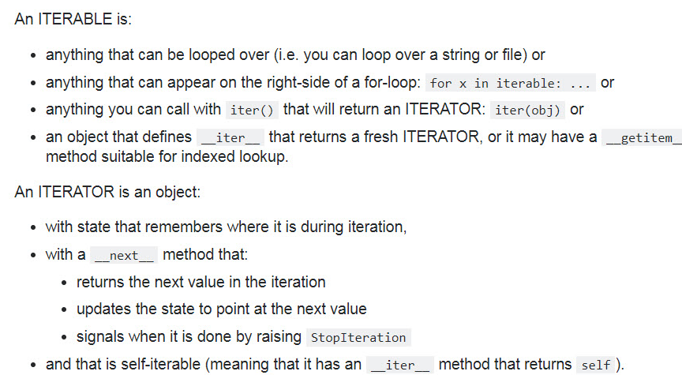
Python Iterable and Iterator

Slide 3
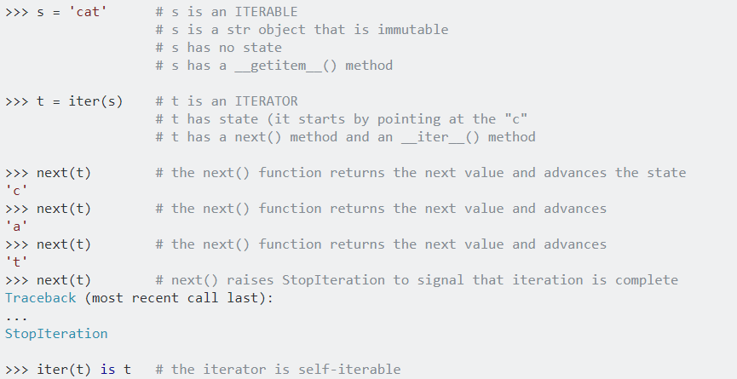
Python Iterable and Iterator

Slide 4
Python Generator
A generator is a function that returns an object (iterator) which we can iterate over (one value at a time).
When called, it returns an object (iterator) but does not start execution immediately.
We can iterate through the items using next().
Once the function yields, the function is paused and the control is transferred to the caller.
Local variables and their states are remembered between successive calls.
Finally, when the function terminates, StopIteration is raised automatically on further calls.

Slide 5

Manual data feed
xy = np.loadtxt('data-diabetes.csv', delimiter=',', dtype=np.float32)
x_data = Variable(torch.from_numpy(xy[:, 0:-1]))
y_data = Variable(torch.from_numpy(xy[:, [-1]]))
...
# Training loop
for epoch in range(100):
# Forward pass: Compute predicted y by passing x to the model
y_pred = model(x_data)
# Compute and print loss
loss = criterion(y_pred, y_data)
print(epoch, loss.data[0])
# Zero gradients, perform a backward pass, and update the weights.
optimizer.zero_grad()
loss.backward()
optimizer.step()

Slide 6
Batch (batch size)
# Training cycle
for epoch in range(training_epochs):
# Loop over all batches
for i in range(total_batch):
batch_xs, batch_ys = …

Slide 7
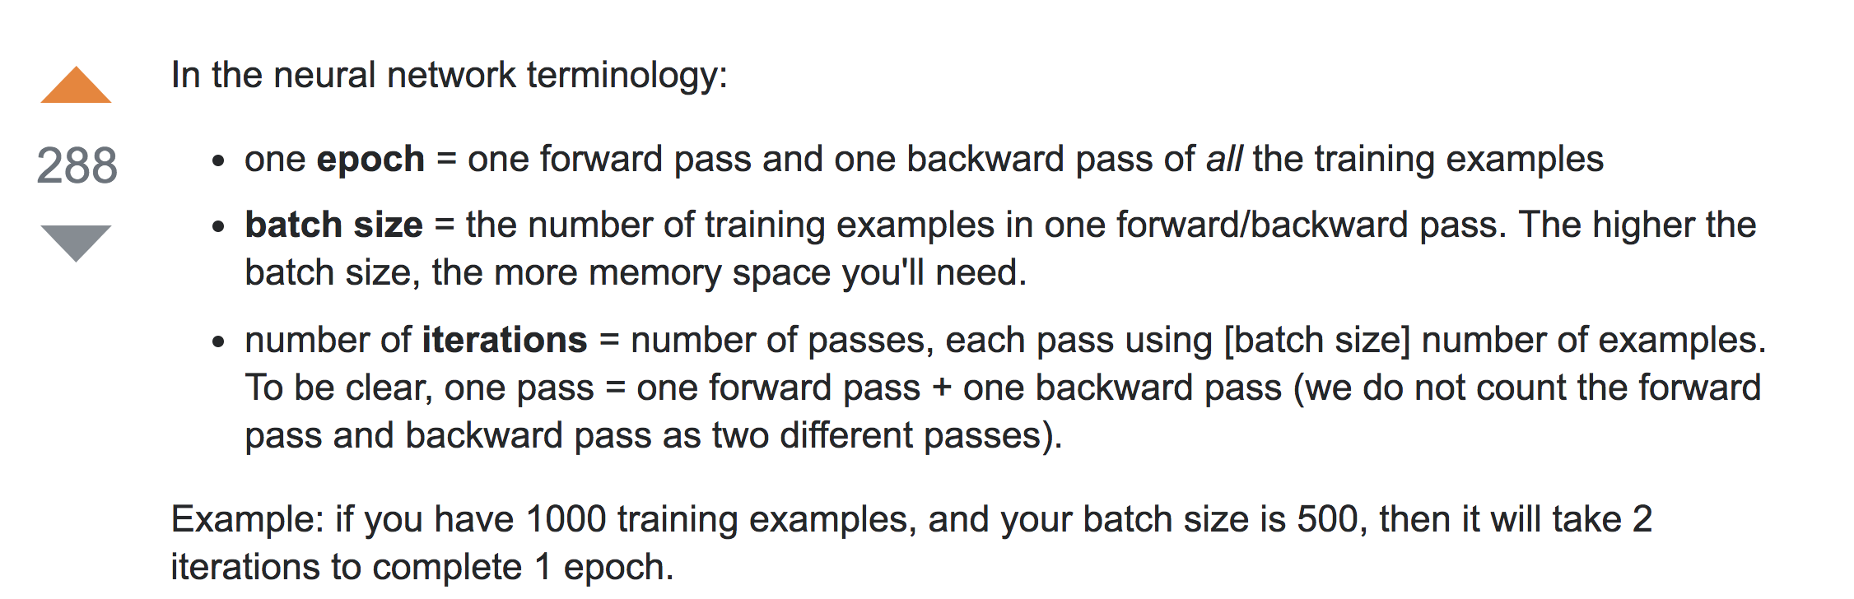
Batch (batch size)
# Training cycle
for epoch in range(training_epochs):
# Loop over all batches
for i in range(total_batch):
batch_xs, batch_ys = …
https://stackoverflow.com/questions/4752626

Slide 8
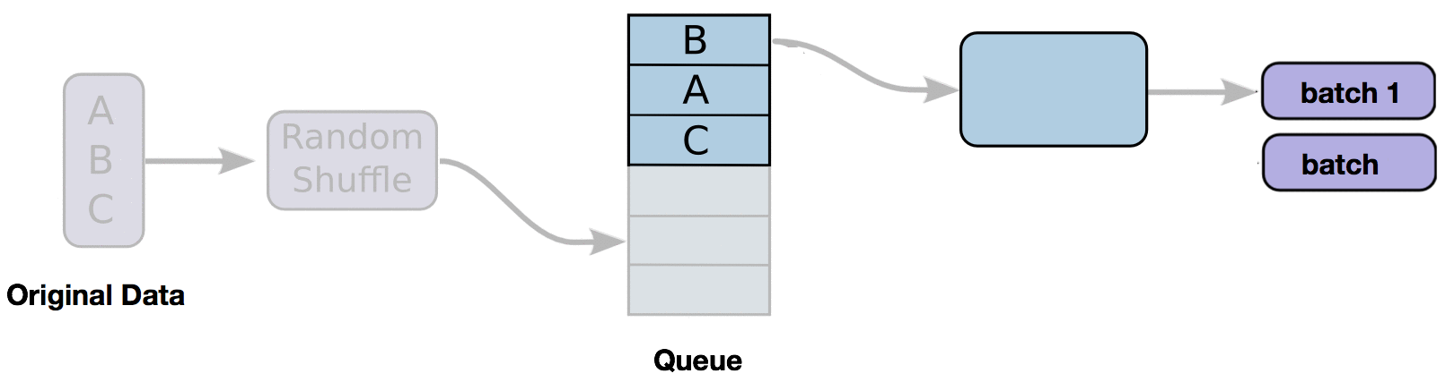
DataLoader
iterable
2
for i, data in enumerate(train_loader, 0):
# get the inputs
inputs, labels = data
# wrap them in Variable
inputs, labels = Variable(inputs), Variable(labels)
# Run your training process
print(epoch, i, "inputs", inputs.data, "labels", labels.data)

Slide 9



Custom DataLoader
class DiabetesDataset(Dataset):
""" Diabetes dataset."""
# Initialize your data, download, etc.
def __init__(self):
xy = np.loadtxt('data-diabetes.csv', delimiter=',', dtype=np.float32)
self.len = xy.shape[0]
self.x_data = torch.from_numpy(xy[:, 0:-1])
self.y_data = torch.from_numpy(xy[:, [-1]])
def __getitem__(self, index):
return self.x_data[index], self.y_data[index]
def __len__(self):
return self.len
dataset = DiabetesDataset()
train_loader = DataLoader(dataset=dataset,
batch_size=32,
shuffle=True,
num_workers=2)
download, read data, etc.
return one item on the index
return the data length
https://github.com/yunjey/pytorch-tutorial

Slide 10
Custom DataLoader
class DiabetesDataset(Dataset):
""" Diabetes dataset."""
# Initialize your data, download, etc.
def __init__(self):
xy = np.loadtxt('data-diabetes.csv', delimiter=',', dtype=np.float32)
self.len = xy.shape[0]
self.x_data = torch.from_numpy(xy[:, 0:-1])
self.y_data = torch.from_numpy(xy[:, [-1]])
def __getitem__(self, index):
return self.x_data[index], self.y_data[index]
def __len__(self):
return self.len
dataset = DiabetesDataset()
train_loader = DataLoader(dataset=dataset,
batch_size=32,
shuffle=True,
num_workers=2)

Slide 11
Using DataLoader
dataset = DiabetesDataset()
train_loader = DataLoader(dataset=dataset, batch_size=32, shuffle=True, num_workers=2)
# Training loop
for epoch in range(2):
for i, data in enumerate(train_loader, 0):
# get the inputs
inputs, labels = data
# wrap them in Variable
inputs, labels = Variable(inputs), Variable(labels)
# Forward pass: Compute predicted y by passing x to the model
y_pred = model(inputs)
# Compute and print loss
loss = criterion(y_pred, labels)
print(epoch, i, loss.data[0])
# Zero gradients, perform a backward pass, and update the weights.
optimizer.zero_grad()
loss.backward()
optimizer.step()

Slide 12

Classifying Diabetes
class Model(torch.nn.Module):
def __init__(self):
"""
In the constructor we instantiate two nn.Linear module
"""
super(Model, self).__init__()
self.l1 = torch.nn.Linear(8, 6)
self.l2 = torch.nn.Linear(6, 4)
self.l3 = torch.nn.Linear(4, 1)
self.sigmoid = torch.nn.Sigmoid()
def forward(self, x):
"""
In the forward function we accept a Variable of input data and we must return
a Variable of output data. We can use Modules defined in the constructor as
well as arbitrary operators on Variables.
"""
out1 = self.sigmoid(self.l1(x))
out2 = self.sigmoid(self.l2(out1))
y_pred = self.sigmoid(self.l3(out2))
return y_pred
# our model
model = Model()
# Construct our loss function and an Optimizer. The call to model.parameters()
# in the SGD constructor will contain the learnable parameters of the two
# nn.Linear modules which are members of the model.
criterion = torch.nn.BCELoss(size_average=True)
optimizer = torch.optim.SGD(model.parameters(), lr=0.1)
# Training loop
for epoch in range(2):
for i, data in enumerate(train_loader, 0):
# get the inputs
inputs, labels = data
# wrap them in Variable
inputs, labels = Variable(inputs), Variable(labels)
# Forward pass: Compute predicted y by passing x to the model
y_pred = model(inputs)
# Compute and print loss
loss = criterion(y_pred, labels)
print(epoch, i, loss.data[0])
# Zero gradients, perform a backward pass, and update the weights.
optimizer.zero_grad()
loss.backward()
optimizer.step()
# References
# https://github.com/yunjey/pytorch-tutorial/blob/master/tutorials/01-basics/pytorch_basics/main.py
# http://pytorch.org/tutorials/beginner/data_loading_tutorial.html#dataset-class
import torch
import numpy as np
from torch.autograd import Variable
from torch.utils.data import Dataset, DataLoader
class DiabetesDataset(Dataset):
""" Diabetes dataset."""
# Initialize your data, download, etc.
def __init__(self):
xy = np.loadtxt('data-diabetes.csv', delimiter=',', dtype=np.float32)
self.len = xy.shape[0]
self.x_data = torch.from_numpy(xy[:, 0:-1])
self.y_data = torch.from_numpy(xy[:, [-1]])
def __getitem__(self, index):
return self.x_data[index], self.y_data[index]
def __len__(self):
return self.len
dataset = DiabetesDataset()
train_loader = DataLoader(dataset=dataset,
batch_size=32,
shuffle=True,
num_workers=2)
Notes:
\hat{y}=x*w+b
loss = \frac{1}{N}\sum_{n=1}^{N} y^{(n)} \log \hat{y}^{(n)} + (1 - y^{(n)}) \log (1-\hat{y}^{(n})

Slide 13
The following dataset loaders are available
MNIST and FashionMNIST
COCO (Captioning and Detection)
LSUN Classification
ImageFolder
Imagenet-12
CIFAR10 and CIFAR100
STL10
SVHN
PhotoTour

Slide 14
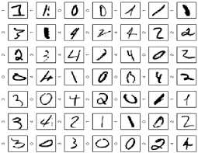
MNIST dataset loading
# MNIST Dataset
train_dataset = datasets.MNIST(root='./data/',
train=True,
transform=transforms.ToTensor(),
download=True)
test_dataset = datasets.MNIST(root='./data/',
train=False,
transform=transforms.ToTensor())
# Data Loader (Input Pipeline)
train_loader = torch.utils.data.DataLoader(dataset=train_dataset,
batch_size=batch_size,
shuffle=True)
test_loader = torch.utils.data.DataLoader(dataset=test_dataset,
batch_size=batch_size,
shuffle=False)
for batch_idx, (data, target) in enumerate(train_loader):
data, target = Variable(data), Variable(target)
...
https://github.com/yunjey/pytorch-tutorial

Slide 15
More dataset loaders are available
MNIST and FashionMNIST
COCO (Captioning and Detection)
LSUN Classification
ImageFolder
Imagenet-12
CIFAR10 and CIFAR100
STL10
SVHN
PhotoTour

Slide 16
Exercise 8-1:
Check out existing data sets (torch.vision)
Build DataLoader for
Titanic dataset: https://www.kaggle.com/c/titanic/download/train.csv
Build a classifier using the DataLoader

